Slide 1
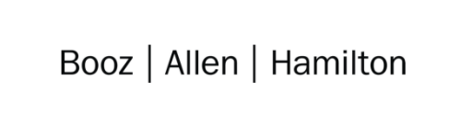

Cloud Excellence Presentation
Team 6 Tech Excellence Cartoon App. Cameron Henderson Robert Simmons Julius Walker Erik Lucas
AUGUST 2021

Slide 2
Team # 6: TOON SQUAD This application will convert regular photos into cartoon, resize and sketch photos
Our Official Project for the
Booz Allen Cloud Excellence Program
www.webagesolutions.com|1.877.517.6540

Slide 3
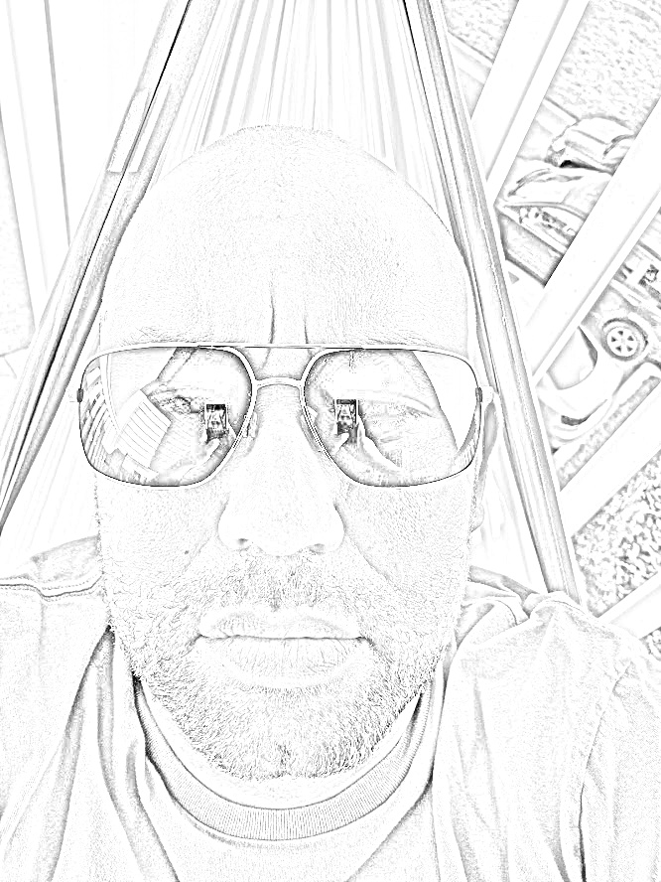
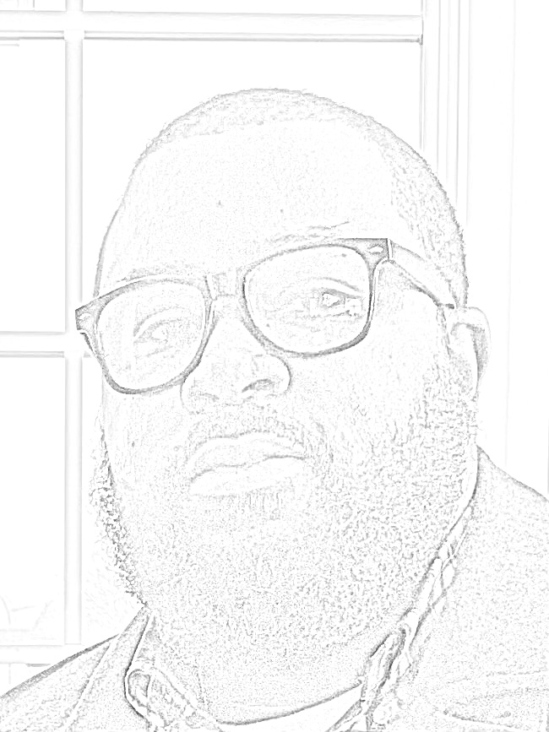
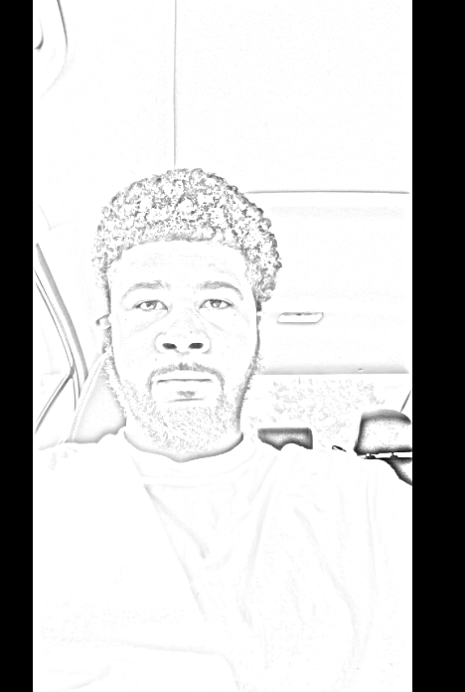
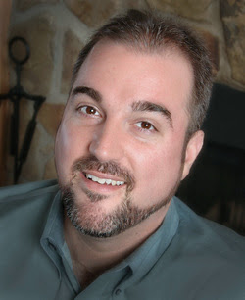
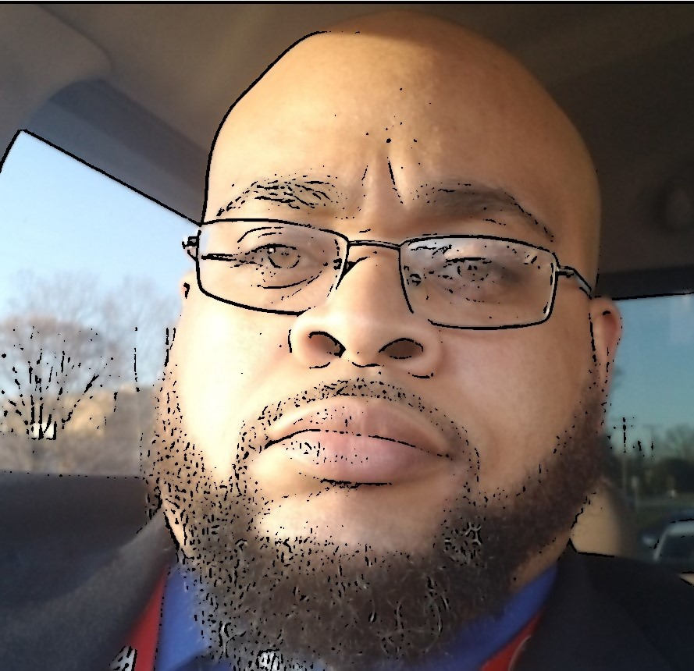
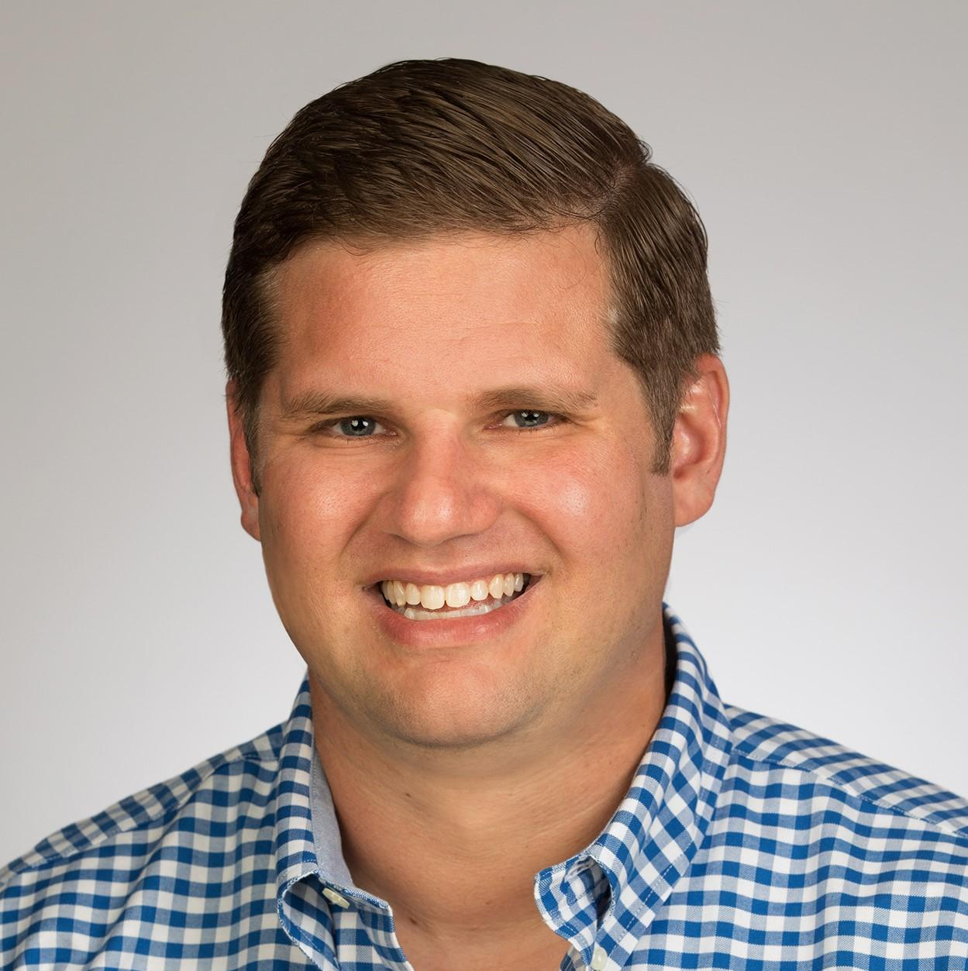
INTRODUCTIONS
ROBERT SIMMONS Cloud Engineer
JULIUS WALKER Cloud Engineer
CAMERON HENDERSON
Cloud Engineer
ERIK LUCAS
Cloud Engineer

Slide 4
Cartoonize Your Image!
Introductions
Project Overview
Architecture/Design diagram
Tools/Software Environment used
Challenges/Issues/Problems/Your stories
What have you learned/learned?
What else can we do on the project? - future plan- any design and implementation ideas?
Demo
Questions and answers
Description
This is a serverless app to turn your photo into a cartoon-like image. There are three filters that you can choose from: Pencil Sketch, Animated Cartoon image, and Image Resize
www.webagesolutions.com|1.877.517.6540

Slide 5


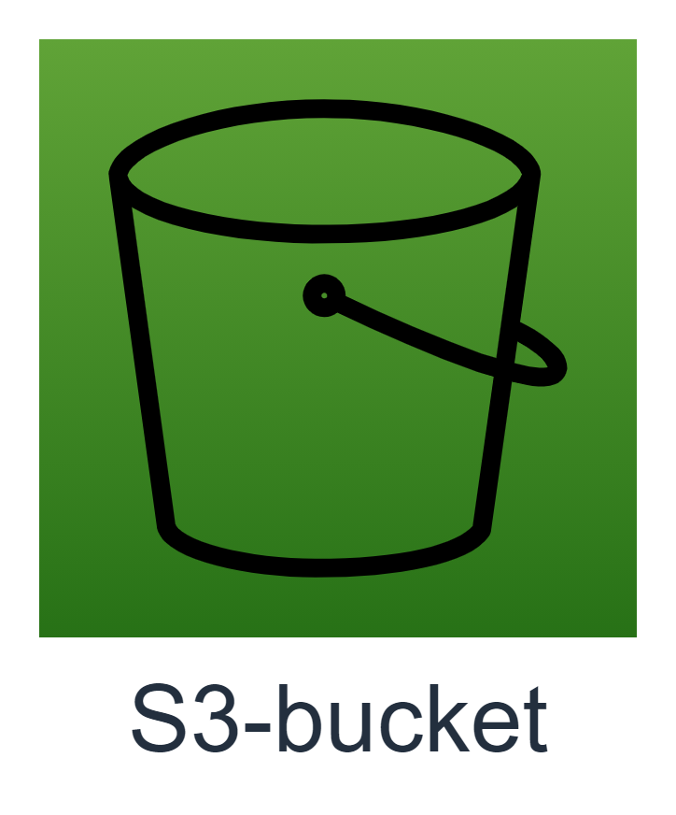



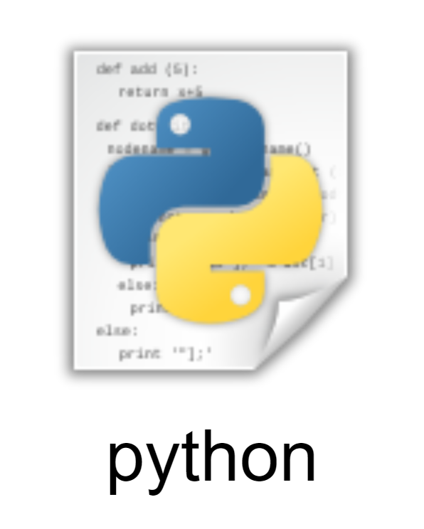
Technologies and Environment used
Environment
AWS S3
Lambda
Git with Github.com
AWS Cloud Formation
Docker
Technologies:
AWS SAM- CLI: Serverless application model

Slide 6
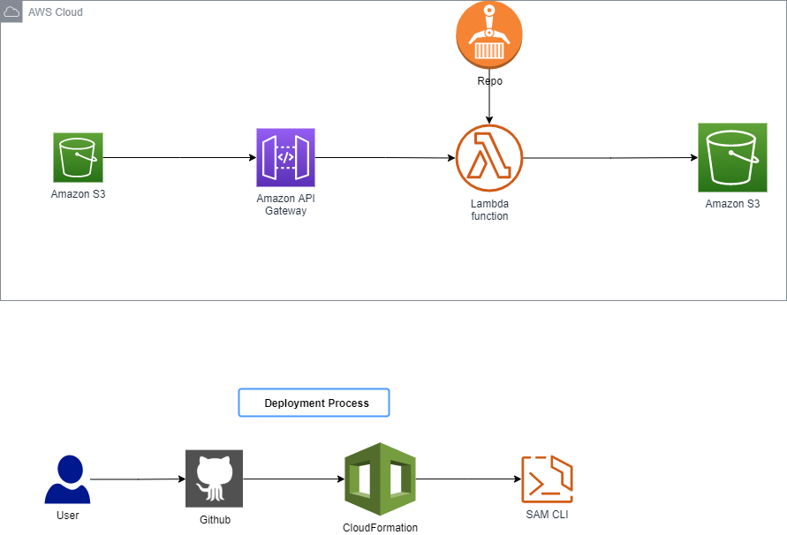
Architecture and Design

Slide 7
Challenges and Issues
Testing revealed execution role permission errors.
SAM CLI
We had to vary from the documentation because we were using python libraries that needed to be deployed as an image and not a zip file.
Timeout
There were timeout issues with Lambda execution.
Error occurs 403
Creating a LAMBDA trigger
The Lambda handler didn’t listen right away. A trigger had to be set up pass events to the Lambda Handler as well as grant permissions to S3.

Slide 8
Demo

Slide 9
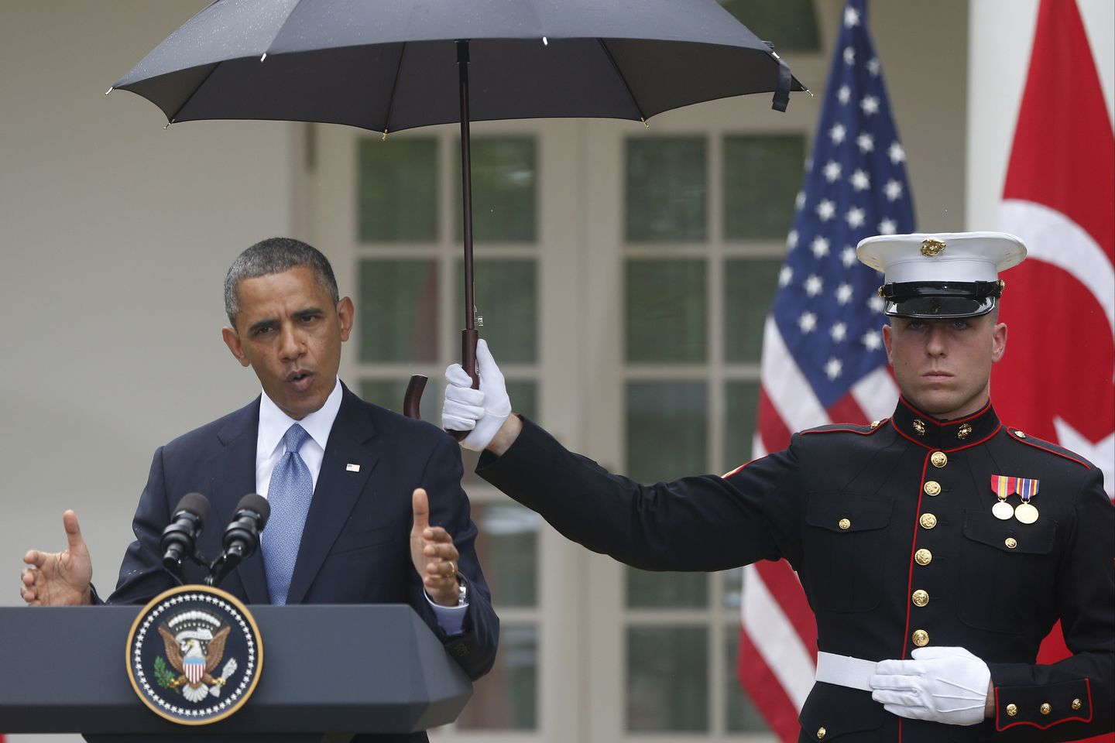
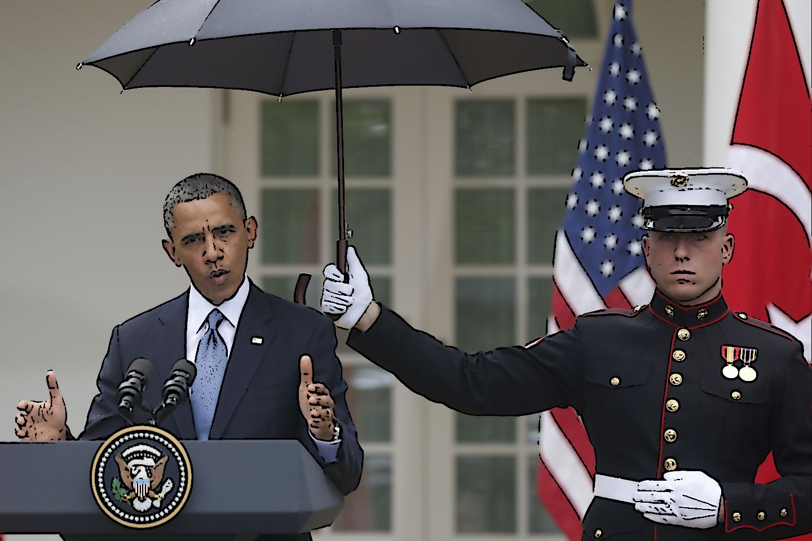
Cartoon Example

Slide 10
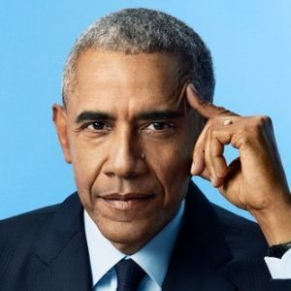

Resize example

Slide 11

Future State - What we would add
Using SNS Pub/Sub so S3 can trigger 3 separate Lambda functions at once.
Using one source bucket that sends to three different destination buckets depending on desired output ; Cartoon, pencil sketch, resize.
We could also use SNS to distribute pre signed URLs to grant access for a particular output for someone who does not have a IAM access

Slide 12
Thank you!!! From Team 6
AUGUST 2021

Slide 13
Q & A - Ask us anything

